Slide 1

IMPLEMENTATION OF PRIVACY PRESERVATION IN PUBLIC CLOUD
BMS College of Engineering
Department of Information Science and Engineering
CAPSTONE PROJECT PHASE -2
Review - III
Batch No:-
Project Team Members:
Gagandeep S (1BM18IS035)
Deevith H T (1BM18IS031)
Under the Guidance of
Prof. Chandrakala G Raju
Assistant Professor
Department of ISE

Slide 2
Introduction
Nowadays developing different systems require various features to cope with the new technologies. So implementing new idea over the cloud has become every day's norm. Besides, they require better security features to prevent unauthorized accesses to the system. To do so we need to develop and use new authorizing methodologies and features. So, when we develop systems, we make sure they are secure and have strong authorizing layers. The risk of uploading data with cloud vendor is the chances of data being misused at hosting environment as the control of the server lies with cloud vendor. This is the major area of concern when the data is hosted in cloud environment.

Slide 3
Motivation
Data validation has become one of the key aspects in the present world scenario. Since the use of hardware storage devices have been reduced over the course of time, tech users are now using virtual cloud to store their personal and professional data. Hence, preserving the authenticity and security of the uploaded data has become the major concern. So, it’s a necessary feature to have extra security to maintain the confidentiality of the data.

Slide 4
Objectives
To obtain API token from the backend for every authorized user and fetch their requests using the token as the passkey.
To make sure it’s a good system that can be applied and used without facing any problems with unauthorized accesses.
To know end-user’s opinions for improving the existing system and generate a better version.
To prove that the system is excellent and can work properly in organization’s environment and be a strong defense for the organization against all the unauthorized people or users.

Slide 5
Literature Survey
SL.NO | Title of the Paper | Problem Addressed | Authors Approach / Method | Results
1 | Cloud Computing Security Challenges and its Potential Solution(2019) | This paper provide the current and future trends of this technology, what services provided by the CC, security issues and challenges, Attacks on the Cloud Computing. | The system maintain the confidentiality of the data. To induce that type of trust in cloud computing, there is required a system which can perform verification, authentication and encrypted data transmission, therefore that should maintain the confidentiality of the data. | the best usage of the model we need to remove the current security issues in cloud computing. So in this paper they used two cryptographic algorithms RSA algorithm and Digital Signature in order to enhance the security.
2 | Enhancing Public Cloud Security by Developing a Model For User Authentication and Data Integrity Checking (2020) | In this paper an enhanced a model for public cloud user authentication and files integrity checking. | Model that uses the two-factor authentication using the username and password and a certificate-based authentication for user authentication. | This proposed model increases user confidence in cloud application as we use symmetric and asymmetric encryption for uploading of files to ensure a secure connection between cloud users and cloud providers, The model also reduces the computation power on user devices.
3 | The State of the Public Cloud: Security Concerns with Cloud Computing(2020) | This paper explores the current state of cloud computing security. | This paper approaches security threats that continue to make such concerns relevant, and examines mitigations to these threats described in the current literature. | It explains the impact of these security risks and their impact on the adoption of cloud computing

Slide 6
SL.NO | Title of the Paper | Problem Addressed | Authors Approach / Method | Results
4 | A Survey on cloud security issues and block chain(2019) | Survey on Privacy, data integrity Preservation in the Cloud environment and cloud security issues using Blockchain | All data are transferred in file format within the groups, those files are encrypted using AES algorithm and integrity is maintained by MD5 or SHA algorithm. The MD5 or SHA algorithm is used to check for the modifications in the data being stored in the cloud storage | Considering the security issues, they have proposed a model which increases the integrity of the data. The increase in connected devices and increase in computation is the need for cloud computing in now a-days trend.
5 | Enforcing Confidentiality and Authentication over Public Cloud Using Hybrid Cryptosystems(2019) | Implementing security for public cloud using different cryptographic encryption techniques like SHA (secure hash algorithms) and blowfish algorithms | Brief discussion of different SHA algorithms and their comparison, also designed Scheme of Encryption and description Process | The projected methodology defends the client in sequence, starting unconstitutional alright to use throughout the purpose in time of message communication and The finding of study work improves with SHA-3, time unit of improvement has been created.

Slide 7
Existing System
To protect the data from misuse there are various approaches proposed. Methods include use of cryptography and mandate an application to be installed in client device for performing the cryptography related operations. Other approaches propose the block wise data encryption access control frame works etc. however these have key management complexities and overheads for user.
The system’s processor plays a key role in encryption and many cloud providers will offer basic encryption of a few database fields such as passwords and account numbers, if data size increases, encryption process slows down.

Slide 8
Proposed System
The proposed model is to have a separate system called ‘authentication System’ that interfaces the users to the cloud servers. Before the user’s request is forwarded to cloud server the request is verified in authentication system. These connections are forwarded to cloud server further to access the data stored at cloud server. The user connections are tracked and identified as coming from authentication server at cloud server. Methods to perform stamping of user’s requests are provided. The goal is to hide the data from everyone except the genuine user.

Slide 9
Problem Statement
Implementing an external authentication software for accessing files uploaded on the public cloud by user. So that nobody including the cloud hosts can access the files without permission.

Slide 10
SYSTEM REQUIREMENT SPECIFICATION
Functional Requirements
Front end authorizing page
Backend server to obtain access token
External storage to store user credentials
Non-functional Requirements
User-friendly
Secure
Compatible
Reliable

Slide 11
Hardware and Software Requirements
Desktop/Laptop
Webcam
Proper Internet Connection
Existing Cloud account over any platform

Slide 12
SYSTEM DESIGN
Every cloud user logs into the system.
And as the authorised person needs to access the files stored in public cloud, he/she is assured the security is their data as we are enabling one more layer of security apart from the one's provided by the hosts of the service.
The data used for our security model will never be shared with the hosts or any other third parties.
Once the user verifies his/her credentials with us, they will get the access token which would be the part of the header is every request they make.
This ensures the total privacy of user data. And allows the user to use all the services without any interruptions or data hindrance.

Slide 13
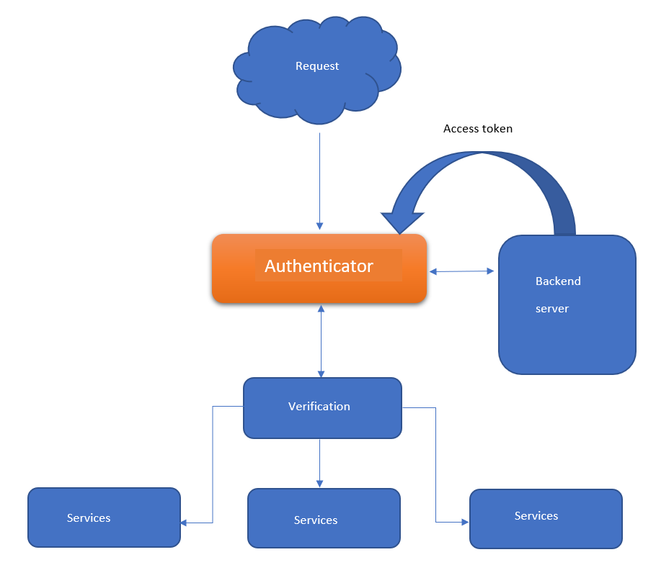

Slide 14
DETAILED DESIGN
User case Design
System
User 1
Admin
Flies
User 2
User 3
Request
Access
Server

Slide 15
Dataflow Diagram
Start
Providing access
Launching
software
Login
Get credentials
Starting server
Logout
Access token
Perform
actions
Provide session access
End
Stopping server
Server

Slide 16
Modules
JS
Home
Login
Flux
Frontend
API
Routes
Admin
Backend

Slide 17
Technology Stack
gitpod.io
Postman
React.js
JWT

Slide 18
Methodology
Considering we have two endpoints or systems that is laptop (client) and a server (API). When a request comes in from the client side that would be an HTTP request from the front end, that request would be answered from the backed server, this communication is stateless, which means that the every new request from the client side , would in a new form without any older knowledge of previous requests. So for every time you do a request from your end you have to tell the backend and verify that the request is from an authorized user. So, we achieve the goal by appending a token as the header of every request we send from our side.

Slide 19
Once the server received the request from the user-end, if the user is unauthorized then it will react with the classic 401 (unauthorized), which is the response for unauthorized request. Else if the user does not have access on a particular file, then it would be responded with a 403 (forbidden) error, which is for an authorized user but permission denial service.
If the user request is authorized then the response code would be 200(allowed). Hence a token as the header of each request is necessary.

Slide 20
Implementation
Steps we have implemented
Create token in the backend
Storing the token in a session storage for a temporary access
Requesting the services with that token
Here, in this module, explained is setting up of a web application with the help of Python, JavaScript and flask.

Slide 21
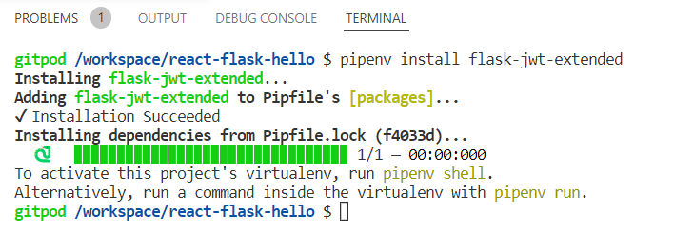
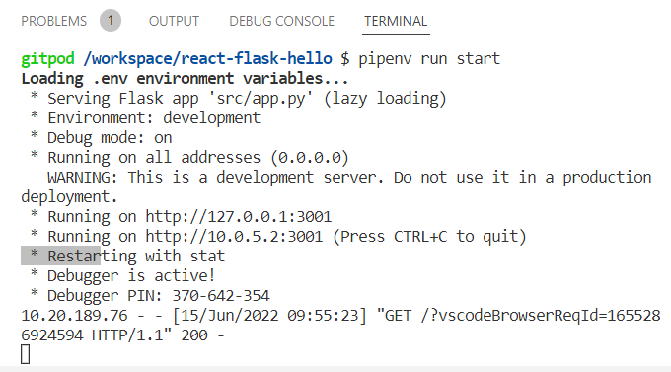
Creating a token:
Step 1- Installation of Flask JWT extended
Step 2- Running the server

Slide 22
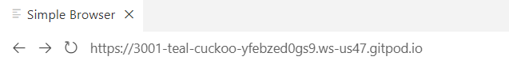
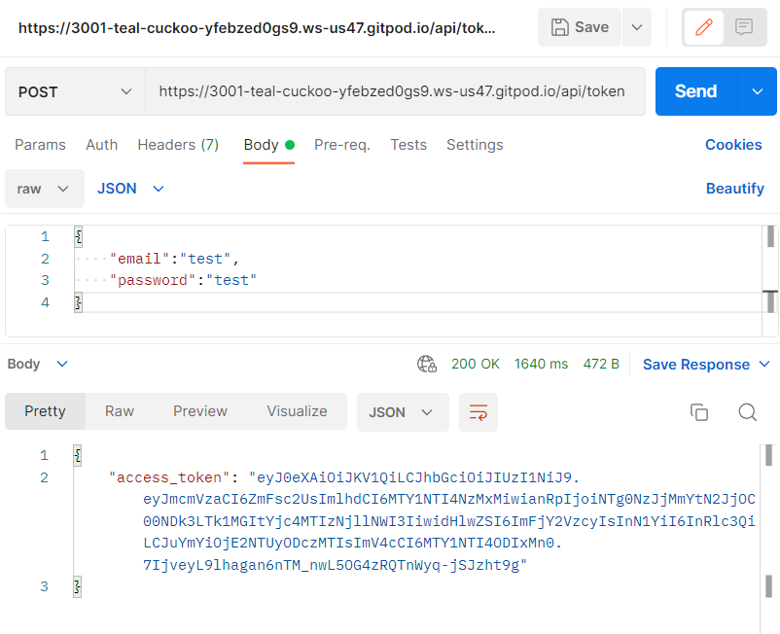
The launching of the API host from our local server
By using postman, and with our API URL generated by the server, create a token by inputting our username and password

Slide 23
2. Storing the token
The storage of the access token needs happen in the session storage of the backend, because a newer access token would be generated for the next login of the authorized user.
Once the token is generated for a given user, he can login and perform action as required and logout by removing the presence and might need to login again with a newer access token for next access onto his public cloud.
While user is inside the cloud system he/she can request any service with that token .

Slide 24
FACE API INCLUSION
We would like to include a biometric verification for our authenticator and generate a new token , which would be aggregated with the previously obtained token and increase the security over the cloud.
Here, we have used a open source face API namely Compreface which provides the service of face verification.
Steps For Implementing Compreface
Initially, we need to set up docker desktop on our service and obtain the compreface archive provided by them. Then run the docker command to start the service and launch the application over the localhost on our system.

Slide 25
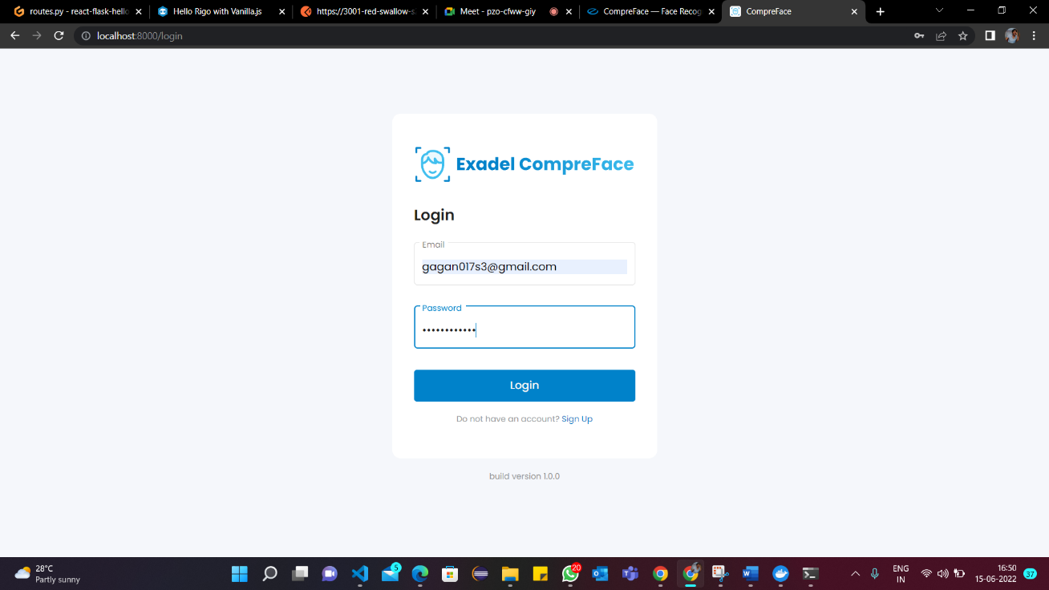
The admin will have to setup up his account and receive the api token to the sample sdk
Later on, the face stored in while registering an user will be used to again verify him and obtain a access token if the similarity index is more than 0.95. This token will be concatenated with the one which will be obtained from username and password previously.

Slide 26
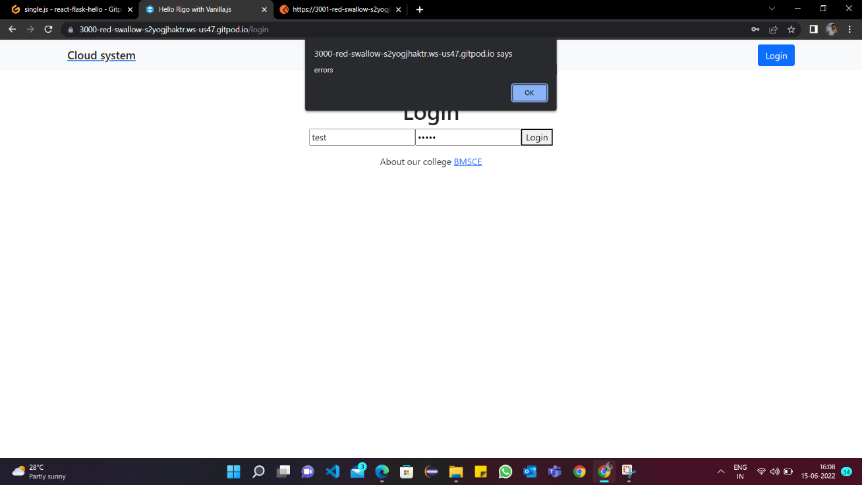
Testing
Shows the error dialog box popping up when a user gives a wrong credentials in the input form .

Slide 27
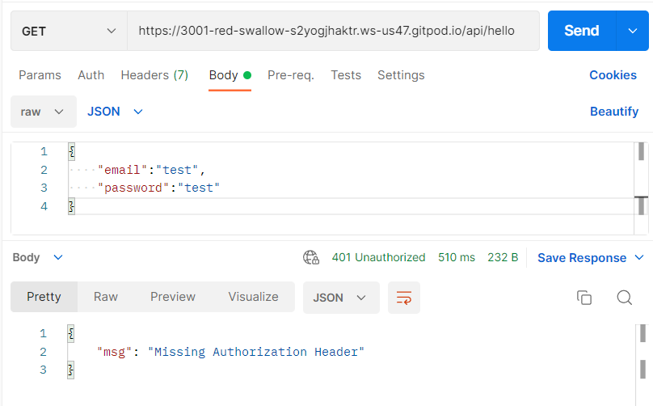
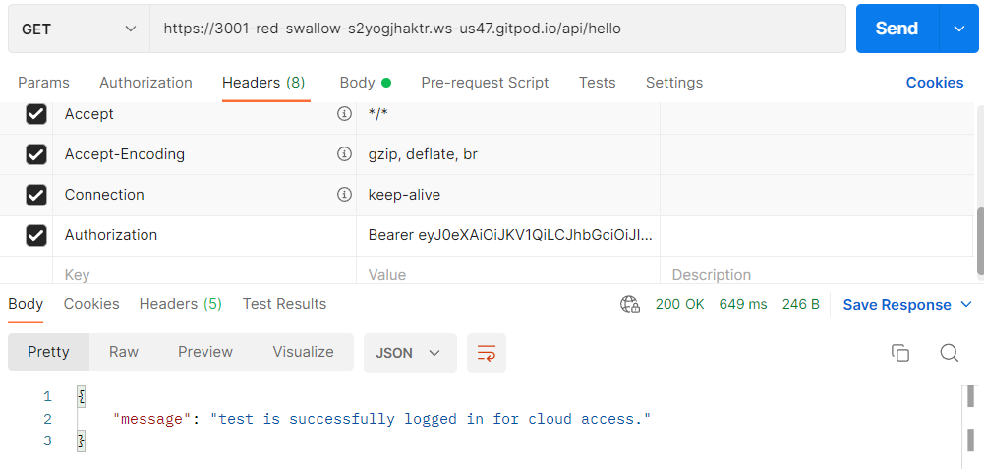
shows that it will show this message when there is no header or token in matching with the header in postman.
When we put token which was produced in the headers naming authorization it will match the header and successfully shows the message. By this way we can check the code in postman itself .

Slide 28
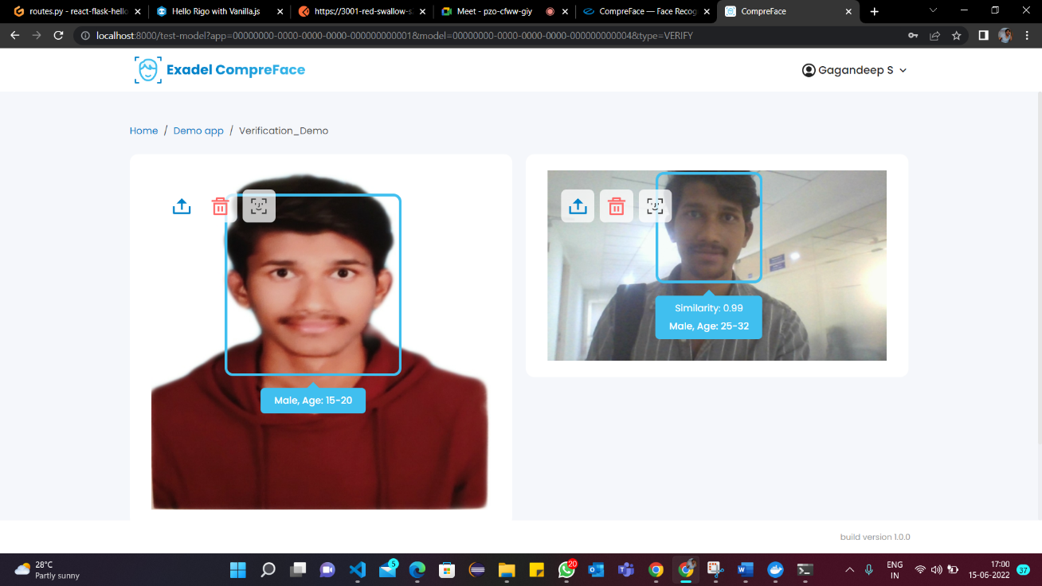
The verification of the images of same person of different age.
The similarity is 0.99~1 .Hence age also a factor that determines the similarity.

Slide 29
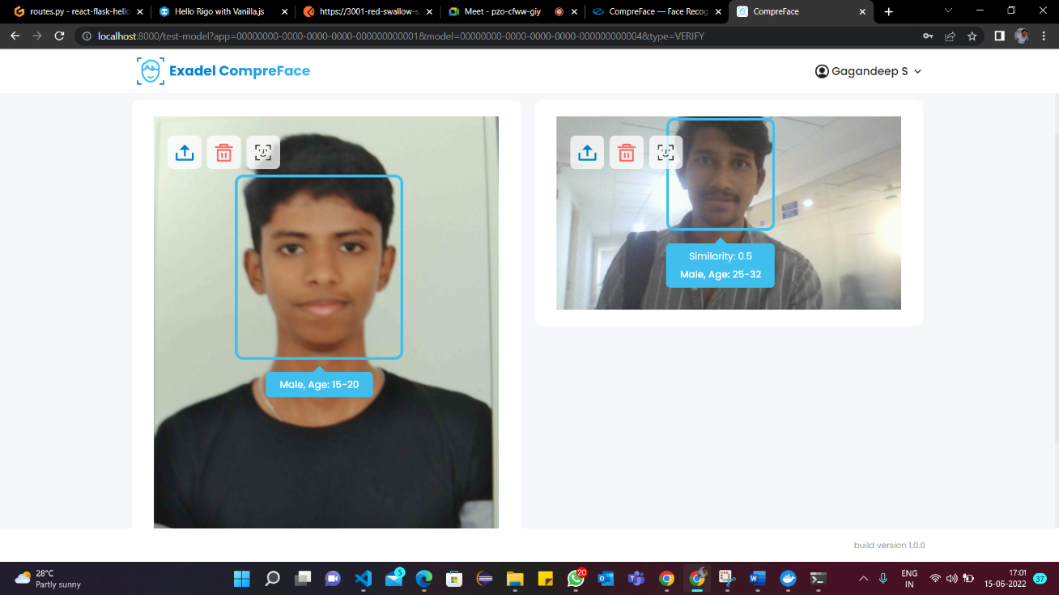
The verification of the images of different person
Here, the similarity is 0.5 which shows that both are two different persons.

Slide 30
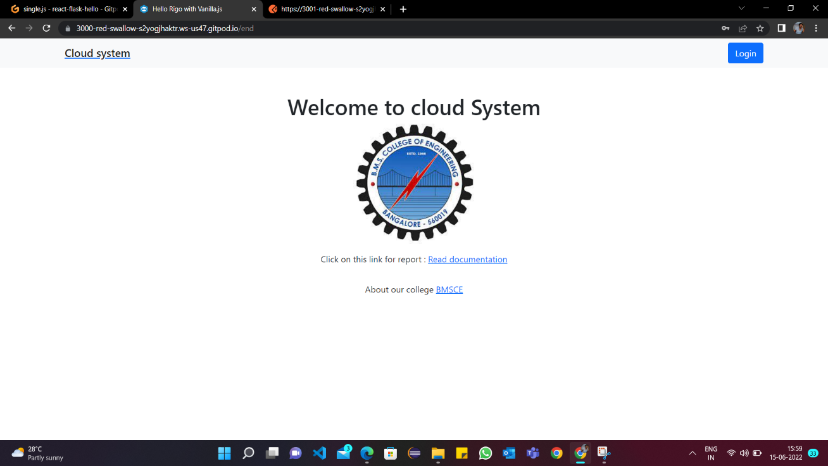
Results
This is the home page of the cloud authentication system.
It consists of two links where one will show the documentation of this project and other one is about the BMS college. After clicking the login button , login page will show up

Slide 31
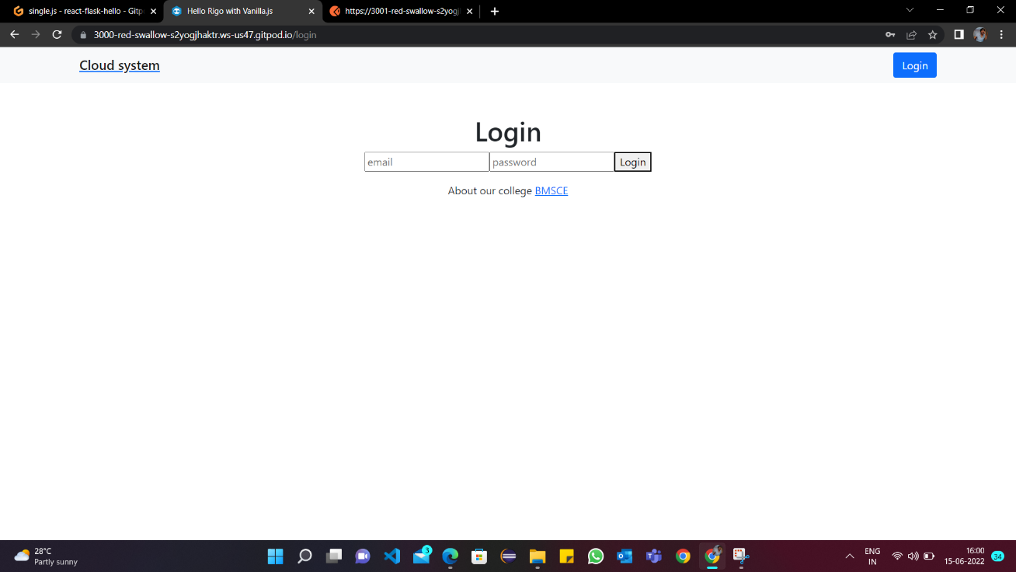
This is the login page where user has to give the login credentials

Slide 32
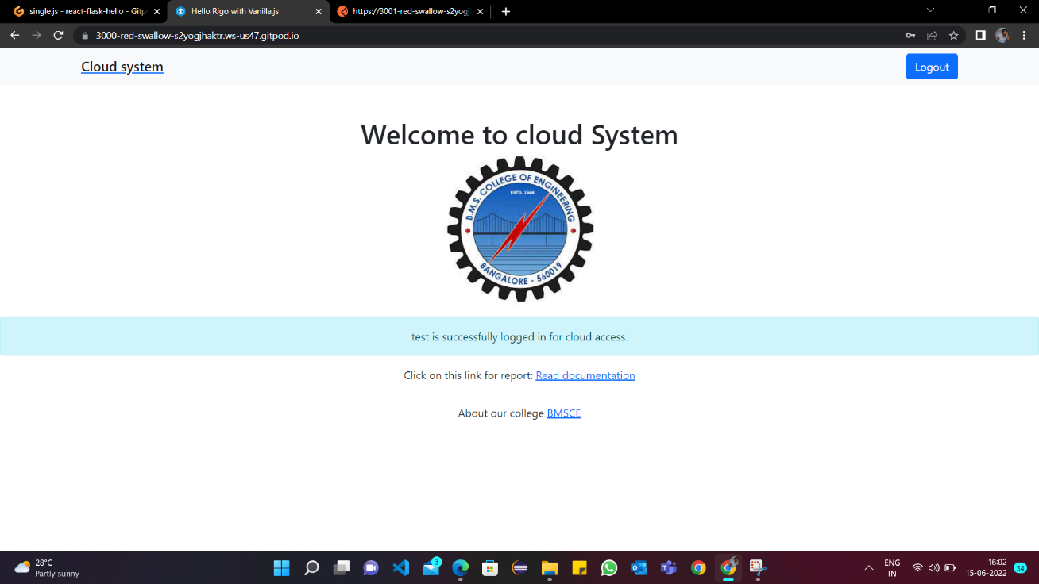
This is the user page after putting correct credentials in login page.
It shows the name of the user entering session succesfully

Slide 33
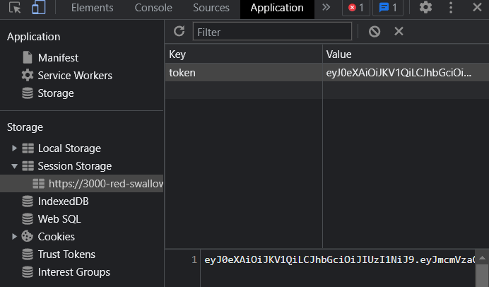
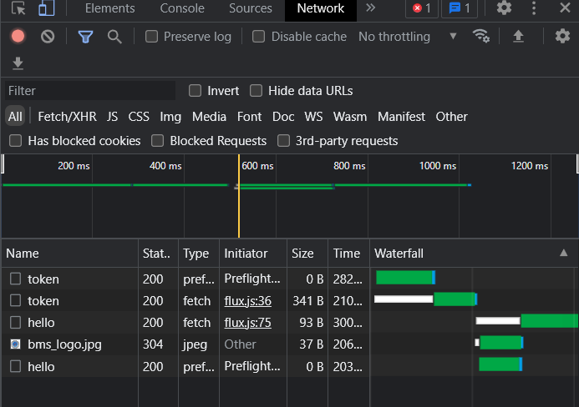
The application inspection of user session
The network inspection of the user session

Slide 34
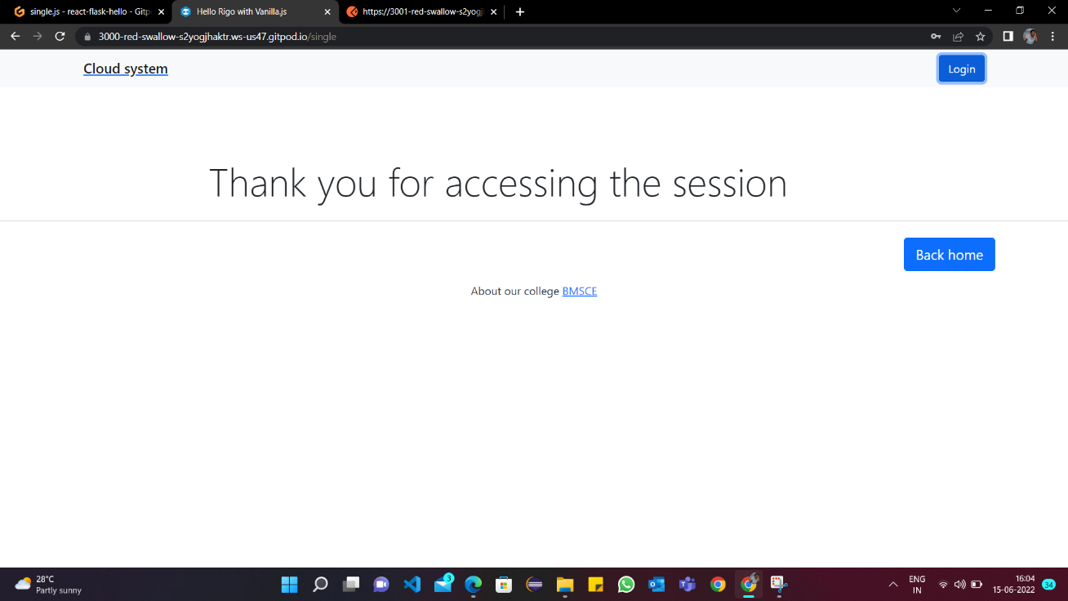
After logging out , the token won’t be there .It will deleted as soon as the session ends.

Slide 35
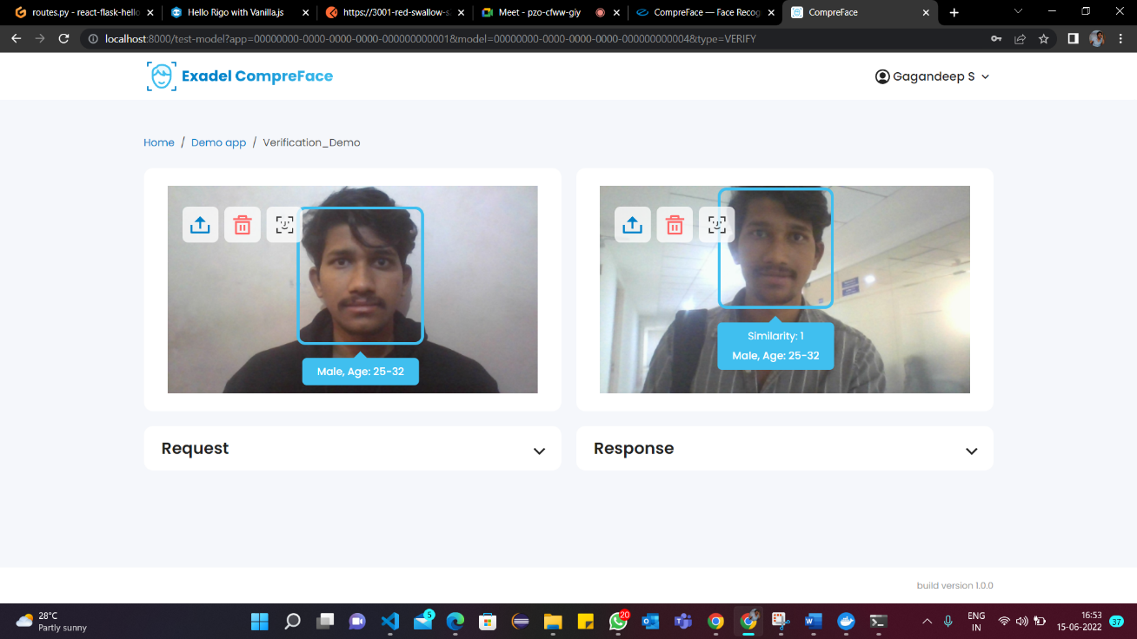
This shows the verification of two images of same person where the similarity is shown as 1 , gender and age of the person .

Slide 36
Conclusion
With the implementation of this system, public cloud seems more secure and reliable. Since we are using external server and storage not only it's safe from third party intervention, but also it blocks the hosts from data accessing. This would solve the major concern like data hindrance, theft and many other tech related problems.
Also, we have verified an accurately working Face API, which would also be helpful for authentication.

Slide 37
Future Enhancement
In the near future, we will have implemented a fully operated sign up for multiple users in our authenticator and combine the FACE API in order to increase the security and make the public cloud more secure for the individuals. This allows authorized users across networks and continents to securely access information stored in the cloud with authentication provided through cloud-based services

Slide 38
Project outcome
We developed a system to generate token for the users who want to access the cloud securely. This application presents a unique method of token generation to securely access cloud files. The developed application also includes user authentication using user name and password . We have also developed a project which uses open face API for authentication . This API has an accuracy rate of 99%. This API along with the develop system even more secure authentication system to access cloud.

Slide 39
References
Xiaodong Yang, Ping Yang, Faying An, Qixu Zhou, Miaomiao Yang ,Traceable Multi-Authority Attribute-based Encryption Scheme for cloud computing , China ,IEEE ,2017.
Bappaditya Jana, Jayanta Poray , A Multilevel Encryption Technique in Cloud Security, West Bengal, IEEE, 2017.
Naseer Amara, Huang Zhiqui , Awais Ali , Lahore, Cloud Computing Security Threats and Attacks with their Mitigation Techniques,China,IEEE,2017.
Amal Ghorbel ,Mahmoud Ghorbel ,Mohamed Jmaiel ,Privacy in cloud computing environments: a survey and research challenges , New York, Springler,2017.
Wg Cdr Nimit Kaura, Lt Col Abhishek Lal , Survey Paper on cloud computing security, India, IEEE,2017.

Slide 40
Ayman M. El-Zoghby , Marianne A. Azer ,Cloud computing Privacy Issues, Challenges and Solutions,Egypt,IEEE,2017.
Shehzad Ashraf Chaudhry1 , Luk Kim , Seungmin Rho ,Mohammad Sabzinejad Farash , Taeshik Shon, An improved anonymous authentication scheme for distributed mobile cloud computing services,Springler,2017.
A.Praveena , Dr.S.Smys , Ensuring Data Security in Cloud Based Social Networks, India , IEEE, 2017.
Mr. Amit Gyandev Prajapati , Mr. Shankarlal Jayantilal Sharma , Mr. Vishal Sahebrao Badgujar ,All About Cloud : A Systematic Survey,India,IEEE,2018.
Alejandro Sanchez-Gomez, Jesus Diaz, Luis Hernandez-Encinas, and David Arroyo ,Review of the Main Security Threats and Challenges in Free-Access Public Cloud Storage Servers,Springler,2018.

Slide 41
Hussam Hourani , Mohammad Abdallah ,Cloud Computing: Legal and Security Issues,IEEE,2018.
Srijita Basu , Arjun Bardhan, Koyal Gupta,Payel Saha, Mahasweta Pal,Manjima Bose, Kaushik Basu,Saunak Chaudhury, Pritika Sarkar ,Cloud Computing Security Challenges & Solutions-A Survey,India,IEEE,2018.
Suryadipta Majumdar , Taous Madi, Yosr Jarraya, Makan Pourzandi, Lingyu Wang, and Mourad Debbabi Cloud Security Auditing: Major Approaches and Existing Challenges ,Canada, Springler,2019.
N. Thillaiarasu, S. Chenthur Pandian, G. Naveen Balaji , R. M. Benitha Shierly , A. Divya , and G. Divya Prabha, Enforcing Confidentiality and Authentication over Public Cloud Using Hybrid Cryptosystems , India, Springler,2019.
S.Pavithra , S.Ramya , Soma Prathibha ,A Survey on cloud security issues and block chain , India , IEEE, 2019.

Slide 42
Srijita Basu , Arjun Bardhan, Koyal Gupta,Payel Saha, Mahasweta Pal,Manjima Bose, Kaushik Basu,Saunak Chaudhury, Pritika Sarkar ,Cloud Computing Security Challenges and its Potential Solution, India, IEEE,2019.
Kennedy A. Torkura , Muhammad I. H. Sukmana , Feng Cheng, and Christoph Meinel ,Cloud Strike: Chaos Engineering for Security and Resiliency in Cloud Infrastructure , Germany, IEEE,2020.
Chandler Cain , David Raymond, J. Scot Ransbottom ,The State of the Public Cloud: Security Concerns with Cloud Computing,IEEE,2020.
Abdulmajeed Raji , Murtada Adam, Enhancing Public Cloud Security by Developing a Model For User Authentication and Data Integrity Checking, Africa, Researchgate,2020.
Leila Megouache, Abdelhafd Zitouni1 and Mahieddine Djoudi, Ensuring user authentication and data integrity in multi‑cloud environment,Springler,2020.

Slide 43
13

